Slide 1
Lecture 1: Introduction to Communications & Networks

Slide 2
Communications
Data communication—examines how data, in the form of energy, travel across some medium from a source to a destination.

Slide 3
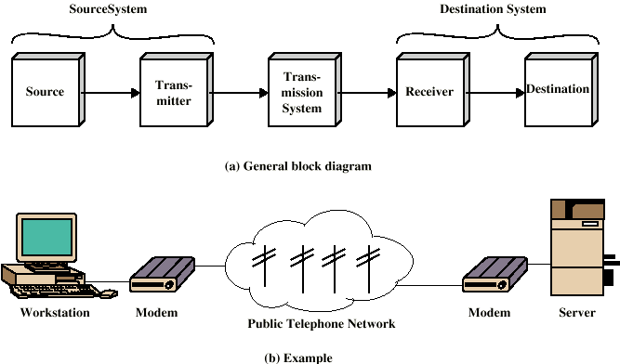
A Simplified Communications Model

Slide 4
A Communications Model
Source
  generates data to be transmitted
Transmitter
  Converts data into transmittable signals
Transmission System
  Carries data
Receiver
  Converts received signal into data
Destination
  Takes incoming data

Slide 5
Data Communications
The term telecommunication means communication at a distance. The word data refers to information presented in whatever form is agreed upon by the parties creating and using the data. Data communications are the exchange of data between two devices via some form of transmission medium such as a wire cable.

Slide 6

Figure 1: Components of a data communication system

Slide 7

Figure 2 Data flow (simplex, half-duplex, and full-duplex)

Slide 8
Networking
Networking — computers communicate with each other via networks.
Computer network — a communication system for connecting computers using a single transmission technology.
A network is a set of devices (often referred to as nodes) connected by communication links. A node can be a computer, printer, or any other device capable of sending and/or receiving data generated by other nodes on the network. A link can be a cable, air, optical fiber, or any medium which can transport a signal carrying information.

Slide 9

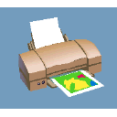


An example of a network
Router
Hub
Bridge
Segment
Node
Hub
Internet

Slide 10
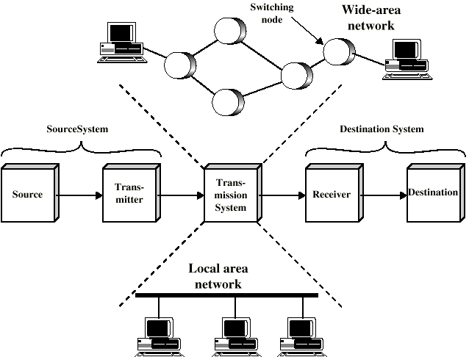
A Simplified Network Model

Slide 11
Network Criteria
Performance
  Depends on Network Elements
  Measured in terms of Delay and Throughput
Reliability
  Failure rate of network components
  Measured in terms of availability/robustness
Security
  Data protection against corruption/loss of data due to:
      Errors
      Malicious users

Slide 12
Physical Structures
Type of Connection
  Point to Point - single transmitter and receiver
  Multipoint - multiple recipients of single transmission
Physical Topology
  Connection of devices
  Type of transmission - unicast, mulitcast, broadcast

Slide 13
Network Topology
Bus topology
Star topology
Ring topology
Fully connected topology
Combined topology

Slide 14

Network Topologies
Bus Topology
  Each node is connected one after the other (like christmas lights)
  Nodes communicate with each other along the same path called the backbone

Slide 15
Ring Topology
  The ring network is like a bus network, but the “end” of the network is connected to the first node
  Nodes in the network use tokens to communicate with each other
Backbone

Slide 16
Star Topology
  Each node is connected to a device in the center of the network called a hub
  The hub simply passes the signal arriving from any node to the other nodes in the network
  The hub does not route the data
Hub

Slide 17
Branching Tree Topology

Slide 18

A fully connected MESH topology (five devices)

Slide 19

A STAR topology connecting four stations

Slide 20

A BUS topology connecting three stations

Slide 21

A RING topology connecting six stations

Slide 22

A HYBRID topology: a star backbone with three bus networks

Slide 23
Categories of Networks
Local Area Networks (LANs)
  Short distances
  Designed to provide local interconnectivity
Wide Area Networks (WANs)
  Long distances
  Provide connectivity over large areas
Metropolitan Area Networks (MANs)
  Provide connectivity over areas such as a city, a campus
Wireless
Inter Network (Internet)

Slide 24
Local Area Network (LAN)
It is also called LAN and designed for small physical areas such as an office, group of buildings or a factory. LANs are used widely as it is easy to design and to troubleshoot. Personal computers and workstations are connected to each other through LANs. We can use different types of topologies through LAN, these are Star, Ring, Bus, Tree etc.
LAN can be a simple network like connecting two computers, to share files and network among each other while it can also be as complex as interconnecting an entire building.
LAN networks are also widely used to share resources like printers, shared hard-drive etc.

Slide 25
Contd.
Characteristics of LAN
LAN's are private networks, not subject to tariffs or other regulatory controls.
LAN's operate at relatively high speed when compared to the typical WAN.
There are different types of Media Access Control methods in a LAN, the prominent ones are Ethernet, Token ring.
It connects computers in a single building, block or campus, i.e. they work in a restricted geographical area.
Applications of LAN
One of the computer in a network can become a server serving all the remaining computers called clients. Software can be stored on the server and it can be used by the remaining clients.
Connecting Locally all the workstations in a building to let them communicate with each other locally without any internet access.
Sharing common resources like printers etc are some common applications of LAN.

Slide 26
Access Control Methods
Two primary access control methods exist for computers to communicate with each other over the network
  Token based access
  Carrier Sense Multiple Access with Collision Detection (CSMA/CD)

Slide 27
Operation of token ring
As an example, suppose node # 1 wants to send information to node # 4 over the network
Initially, an empty frame circulates in the network
1
6
2
3
5
4

Slide 28
When node # 1 receives the empty frame, it inserts a token in the token bit part of the frame. This operation may just be an insertion of a “1” bit
The node then inserts the message it wants to send as well as the address of the receiving node in the frame
The frame is then successively received and examined by each node in the network. First it is sent to node #2. Node #2 examines the frame and compares the address in the frame to its own address. Since addresses do not match, it passes the frame onto node #3, which does the same thing
When the frame is received by node #4, the address of the node matches the destination address within the frame. The node copies the message and changes the token bit in the frame to “0”
The frame is then sent over to node #5. This node also compares addresses and sends it to node #6 which does the same procedure
When node #1 receives the frame, it examines the token bit and recognizes that it has been changed to “0”. Node #1 then concludes that the message has been received by the intended node: node #4. Node #1 then empties the frame and releases the empty frame back into the network for circulation

Slide 29
CSMA/CD
Usually used in a bus topology
Used in Ethernet LAN’s
Unlike the token ring, all nodes can send whenever they have data to transmit
When a node wants to transmit information, it first “listens” to the network. If no one is transmitting over the network, the node begins transmission
It is however possible for two nodes to transmit simultaneously thinking that the network is clear
When two nodes transmit at the same time, a collision occurs
The first station to detect the collision sends a jam signal into the network
Both nodes back off, wait for a random period of time and then re-transmit

Slide 30
Contd.
Advantages of LAN
Resource Sharing: Computer resources like printers, modems, DVD-ROM drives and hard disks can be shared with the help of local area networks. This reduces cost and hardware purchases.
Software Applications Sharing: It is cheaper to use same software over network instead of purchasing separate licensed software for each client a network.
Easy and Cheap Communication: Data and messages can easily be transferred over networked computers.
Centralized Data: The data of all network users can be saved on hard disk of the server computer. This will help users to use any workstation in a network to access their data. Because data is not stored on workstations locally.
Data Security: Since, data is stored on server computer centrally, it will be easy to manage data at only one place and the data will be more secure too.
Internet Sharing: Local Area Network provides the facility to share a single internet connection among all the LAN users. In Net Cafes, single internet connection sharing system keeps the internet expenses cheaper.

Slide 31
Contd.
Disadvantages of LAN
High Setup Cost: Although the LAN will save cost over time due to shared computer resources, but the initial setup costs of installing Local Area Networks is high.
Privacy Violations: The LAN administrator has the rights to check personal data files of each and every LAN user. Moreover he can check the internet history and computer use history of the LAN user.
Data Security Threat: Unauthorised users can access important data of an organization if centralized data repository is not secured properly by the LAN administrator.
LAN Maintenance Job: Local Area Network requires a LAN Administrator because, there are problems of software installations or hardware failures or cable disturbances in Local Area Network. A LAN Administrator is needed at this full time job.
Covers Limited Area: Local Area Network covers a small area like one office, one building or a group of nearby buildings.

Slide 32
Wide Area Network (WAN)
It is also called WAN. WAN can be private or it can be public leased network. It is used for the network that covers large distance such as cover states of a country. It is not easy to design and maintain. Communication medium used by WAN are PSTN or Satellite links. WAN operates on low data rates.
Characteristics of WAN
It generally covers large distances(states, countries, continents).
Communication medium used are satellite, public telephone networks which are connected by routers.

Slide 33
Contd.
Advantages of WAN
Covers a large geographical area so long distance business can connect on the one network.
Shares software and resources with connecting workstations.
Messages can be sent very quickly to anyone else on the network. These messages can have picture, sounds or data included with them(called attachments).
Expensive things(such as printers or phone lines to the internet) can be shared by all the computers on the network without having to buy a different peripheral for each computer.
Everyone on the network can use the same data. This avoids problems where some users may have older information than others.

Slide 34
Contd.
Disadvantages of WAN
Need a good firewall to restrict outsiders from entering and disrupting the network.
Setting up a network can be an expensive, slow and complicated. The bigger the network the more expensive it is.
Once set up, maintaining a network is a full-time job which requires network supervisors and technicians to be employed.
Security is a real issue when many different people have the ability to use information from other computers. Protection against hackers and viruses adds more complexity and expense.

Slide 35
Metropolitan Area Network (MAN)
It is basically a bigger version of LAN. It is also called MAN and uses the similar technology as LAN. It is designed to extend over the entire city. It can be means to connecting a number of LANs into a larger network or it can be a single cable. It is mainly hold and operated by single private company or a public company.
Characteristics of MAN
It generally covers towns and cities (50 km)
Communication medium used for MAN are optical fibers, cables etc.
Data rates adequate for distributed computing applications.

Slide 36
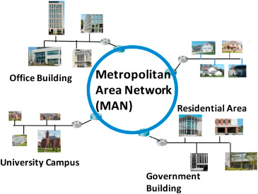

Slide 37
Contd.
Advantages of MAN
Extremely efficient and provide fast communication via high-speed carriers, such as fibre optic cables.
It provides a good back bone for large network and provides greater access to WANs.
The dual bus used in MAN helps the transmission of data in both directions simultaneously.
A MAN usually encompasses several blocks of a city or an entire city.
Disadvantages of MAN
More cable required for a MAN connection from one place to another.
It is difficult to make the system secure from hackers and industrial espionage(spying) graphical regions.

Slide 38
Wireless Network
Digital wireless communication is not a new idea. Earlier, Morse code was used to implement wireless networks. Modern digital wireless systems have better performance, but the basic idea is the same.
Wireless Networks can be divided into three main categories:
System interconnection
Wireless LANs
Wireless WANs

Slide 39
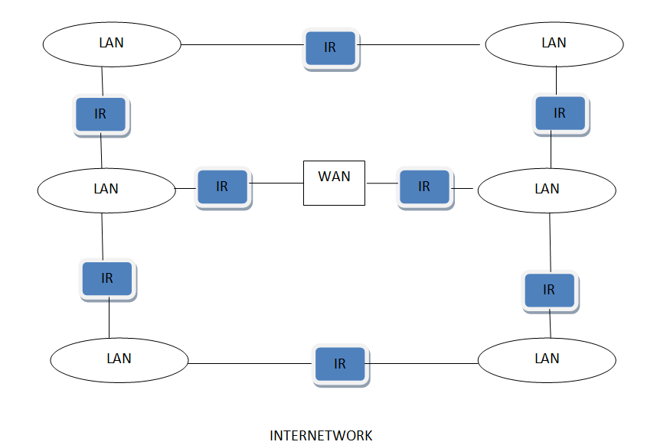
Inter Network
Inter Network or Internet is a combination of two or more networks. Inter network can be formed by joining two or more individual networks by means of various devices such as routers, gateways and bridges.

Slide 40
Queries

